Slide 1

Telecom Churn Prediction Using Machine Learning
Will this customer churn or not?
Will a user downgrade a pricing plan?
Are there any signs of unusual customer behavior?
Team O

Slide 2
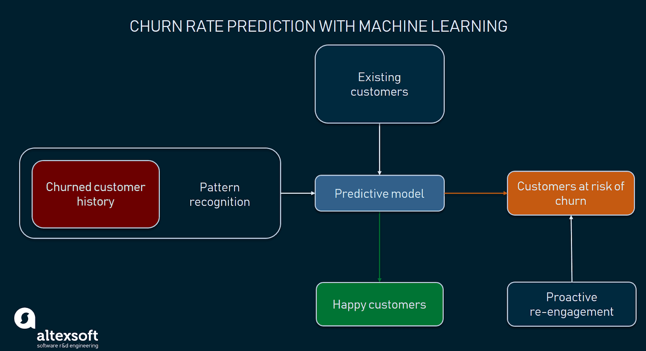
Motivation- To understand the classic aChurn problem in depth from the perspective of building a model
How to build this predictive model???
Reference:https://www.kdnuggets.com/2019/05/churn-prediction-machine-learning.html

Slide 3
Churn prediction detecting customers who are likely to cancel a subscription to a service. Churn is a problem for telecom companies because it is more expensive to acquire a new customer than to keep your existing one from leaving.
Step 1- Identify Problem Statements
Step 2- Data Collection
Voluntary churn is when the customer decides to cancel and takes the necessary steps to exit the service. It could be caused by dissatisfaction, or not receiving the value they expected.
To predict Customer churn
Factor Affecting Customer Churn
what's the most profitable service types?
What's the amount lose in revenue?
Measres to alleiviate
Identifying at-risk customers,
Identifying customer pain points,
Identifying strategy/methods to lower churn and increase customer retention.
The sample data tracks a fictional telecommunications company, Telco. It’s customer churn data sourced by the IBM Developer Platform. It has data for 7043 clients, with 20 features.
There’s a prediction feature: Churn: Whether the customer churned or not (Yes or No)
These remaining features can also be subdivided into:
Demographic customer information: gender , SeniorCitizen , Partner , Dependents
Services that each customer has signed up for: PhoneService , MultipleLines , InternetService , OnlineSecurity , OnlineBackup , DeviceProtection , TechSupport , StreamingTV , StreamingMovies,
Customer account information:tenure , Contract , PaperlessBilling , PaymentMethod , MonthlyCharges , TotalCharges
Overview of the dataset:
Number of rows: 7043
nNumber of features: 21
customerID', 'gender', 'SeniorCitizen', 'Partner', 'Dependents', 'tenure', 'PhoneService', 'MultipleLines', 'InternetService', 'OnlineSecurity', 'OnlineBackup', ‘
DeviceProtection’, 'TechSupport’,StreamingTV', 'StreamingMovies', 'Contract', 'PaperlessBilling', 'PaymentMethod', 'MonthlyCharges', 'TotalCharges', 'Churn']

Slide 4
Step 3- Exploratory Data Analysis
Churn: No – 73.5%
Churn: Yes – 26.5%
Gender - The churn percent is almost equal in case of Male and Females
The percent of churn is higher in case of senior citizens
Customers with Partners and Dependents have lower churn rate as compared to those who don't have partners & Dependents.
Churn rate is much higher in case of Fiber Optic Internet Services.
Customers who do not have services like No OnlineSecurity , Online Backup and TechSupport have left the platform in month.
A larger percent of Customers with monthly subscription have left when compared to Customers with one or two year contract.
Churn percent is higher in case of customers having paperless billing option.
Customers who have Electronic Check Payment Method tend to leave the platform more when compared to other options.
75% of churners pay between 60 and 100 dollars a month
One important mark we can see in this plots that 50% of Churners leave the company before the first year goes by
31% of total revenue was "lost" by people who left.
Optical fiber is responsible for 53% (168,99k) of the monthly revenue, DSL 37% (118,14k)
87% of all monthly revenue lost are caused by customers with Month-to-Month Contracts

Slide 5
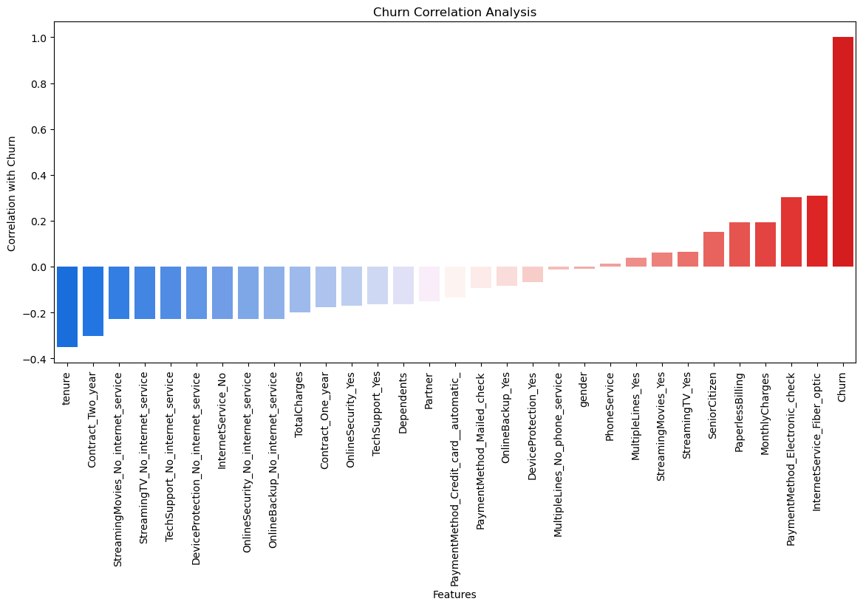

Slide 6
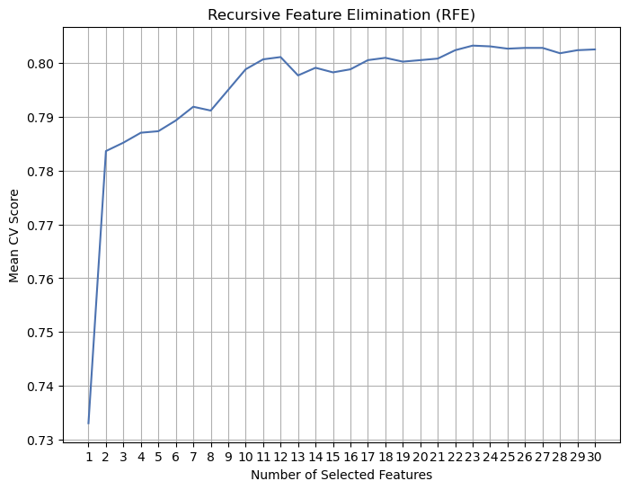
Step 4- Feature Engineering
Step 5- Feature Selection
Encode categorical features
Encoding binary category variables
Encoding the other categoric features with more than two categories
Dropping CustomerId column
Checking Correlation matrix
Linear relationship between two variables
Features with high correlation dropped
Generalized linear model
Absolute p-value is smaller than 0.05
exponential coefficient estimates the expected change in churn
Feature Scaling
Min Max Scaler for numeric features
The optimal number of features: 23

Slide 7
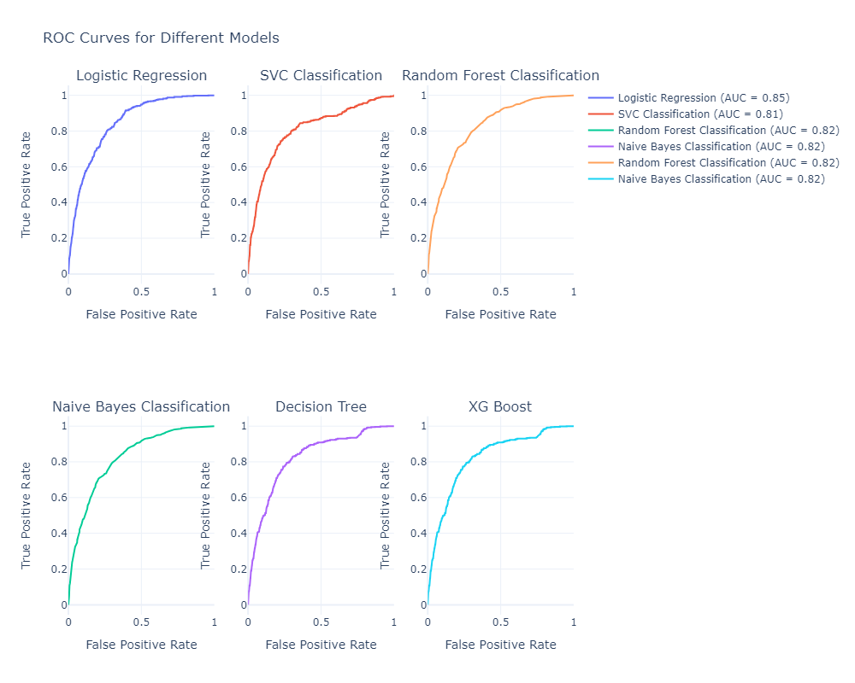
Logistic Regression
accuracy: 0.8017037387600567
SVC Classification
accuracy: 0.7993374349266446
precision: 0.6494382022471911
recall: 0.518850987432675
f1_score: 0.7916082146150322
Random Forest Classification
accuracy: 0.7856128726928537
precision: 0.6106382978723405
recall: 0.5152603231597845
f1_score: 0.7794474465563895
Decision Tree Classification
accuracy: 0.7288215806909607
precision: 0.4866666666666667
recall: 0.5242369838420108
f1_score: 0.7319610137369407
Naive Bayes Classification
accuracy: 0.6540463795551349
precision: 0.4257679180887372
recall: 0.895870736086176
f1_score: 0.6729702812977834
precision: 0.6374501992031872
recall: 0.5745062836624776
f1_score: 0.7982762676502377
XG Boost
accuracy: 0.7827733080927591
precision: 0.5942307692307692
recall: 0.5547576301615799
f1_score: 0.7803181113230403
Step 6-Build Models

Slide 8
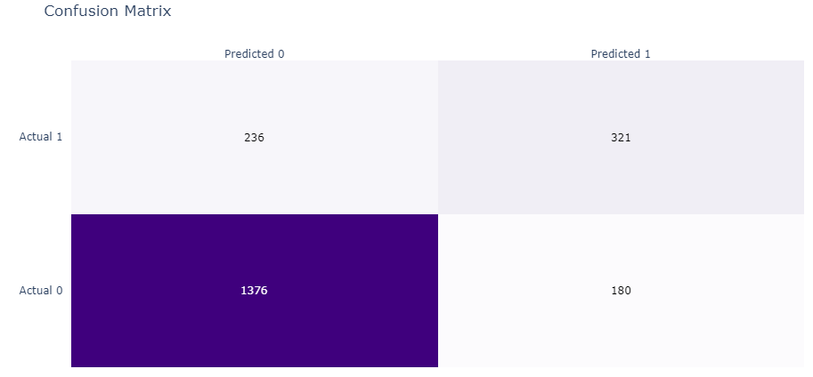
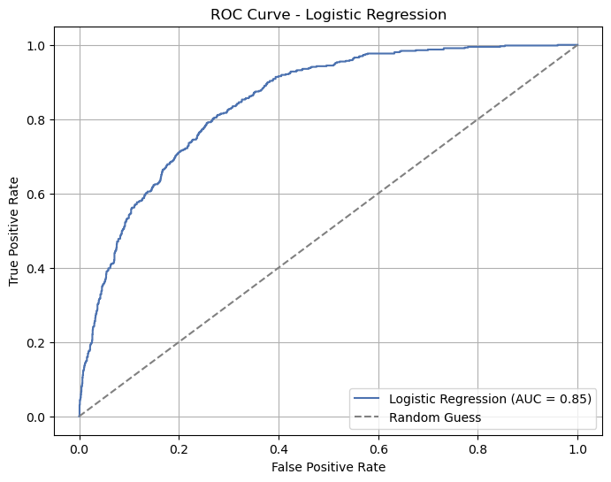
Step 7-Hyperparameter Tuning
Model Initialization:
Cross-Validation Setup:
Repeated Stratified K-Fold cross-validation used with 10 splits and 3 repeats.
Hyperparameter Search Space:
Hyperparameter Search:
Best Hyperparameters
Logistic regression model initialized with default hyperparameters.
Ensures preservation of class distribution in each fold.
Defined a search space for hyperparameters:
'solver': ['newton-cg', 'lbfgs', 'liblinear']
'penalty': ['none', 'l1', 'l2', 'elasticnet']
'C': log-uniform distribution from 1e-5 to 1000.
Performed Randomized Search CV with 500 iterations.
Evaluated hyperparameter combinations using cross-validation with 'accuracy' scoring.
Best Score: 0.8045796394799054
Best Hyperparameters: {'C': 105.95953102146522, 'penalty': 'l2', 'solver': 'liblinear'}
Logistic Regression Classification
accuracy: 0.8031235210601041
precision: 0.6407185628742516
recall: 0.5763016157989228
f1_score: 0.7996532493520713

Slide 9
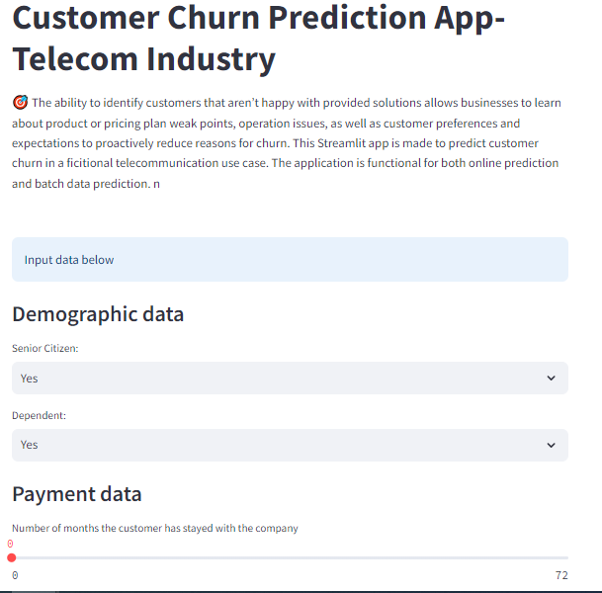
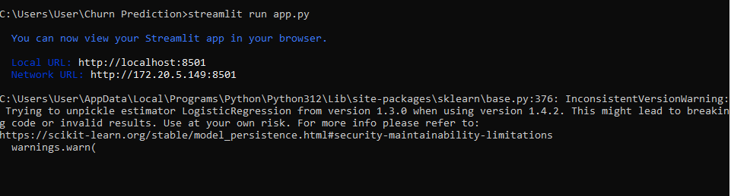
Step 8a-Model Deployment
Step 8b-Learnings?
SMOTE oversampling
Understand how to remove co-related features but not reduce the model efficiency
Permutation importance,
ELI5 Python package, and
SHAP (SHapley Additive exPlanations)

Slide 10
Step 9-Conclusion and Ideas
Use the App to predict churn probabilities
Engage with your customers.
Customers can be divided into subgroups based on their lifecycle stage, needs, used solutions, level of engagement monetary value, or basic information
Learning the relationship between observations made
Customer event history V/S Response window
Flaunt your competitive advantage
Pain areas
Customer Segmentation
Define your most valuable customers
Observation Window
Perks for long term contracts
Alternate cheaper plans
Competitive pricing
Customer segmentation.
Selecting an observation window
Troubleshooting pain areas
References: https://stackoverflow.com/questions/76593906/how-to-resolve-cannot-import-name-missingvalues-from-sklearn-utils-param-v, https://www.kdnuggets.com/2019/05/churn-prediction-machine-learning.html, https://streamlit.io/, https://scikit-learn.org/stable/, https://chatgpt.com/,

